Slide 1
Contents
Project vision
City Information Open Platform
General Architecture
Example
Business Use Cases (Tamky city)
After first touch

Slide 2
Project Vision
Create a system that maintains a fundamental database for a smart city.
A platform to provide services and utilities related to smart city to citizens
Provide implementations to get involved of citizens (citizen engagement) on making decisions and policies related to smart city operations

Slide 3
City Information Open Platform (General architecture)

Slide 4
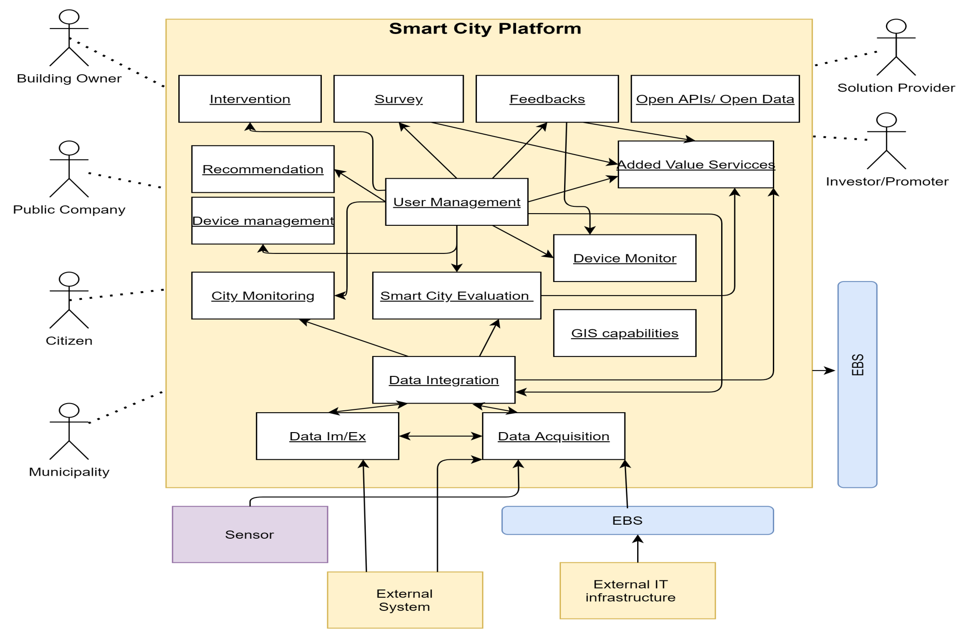
A Context View

Slide 5
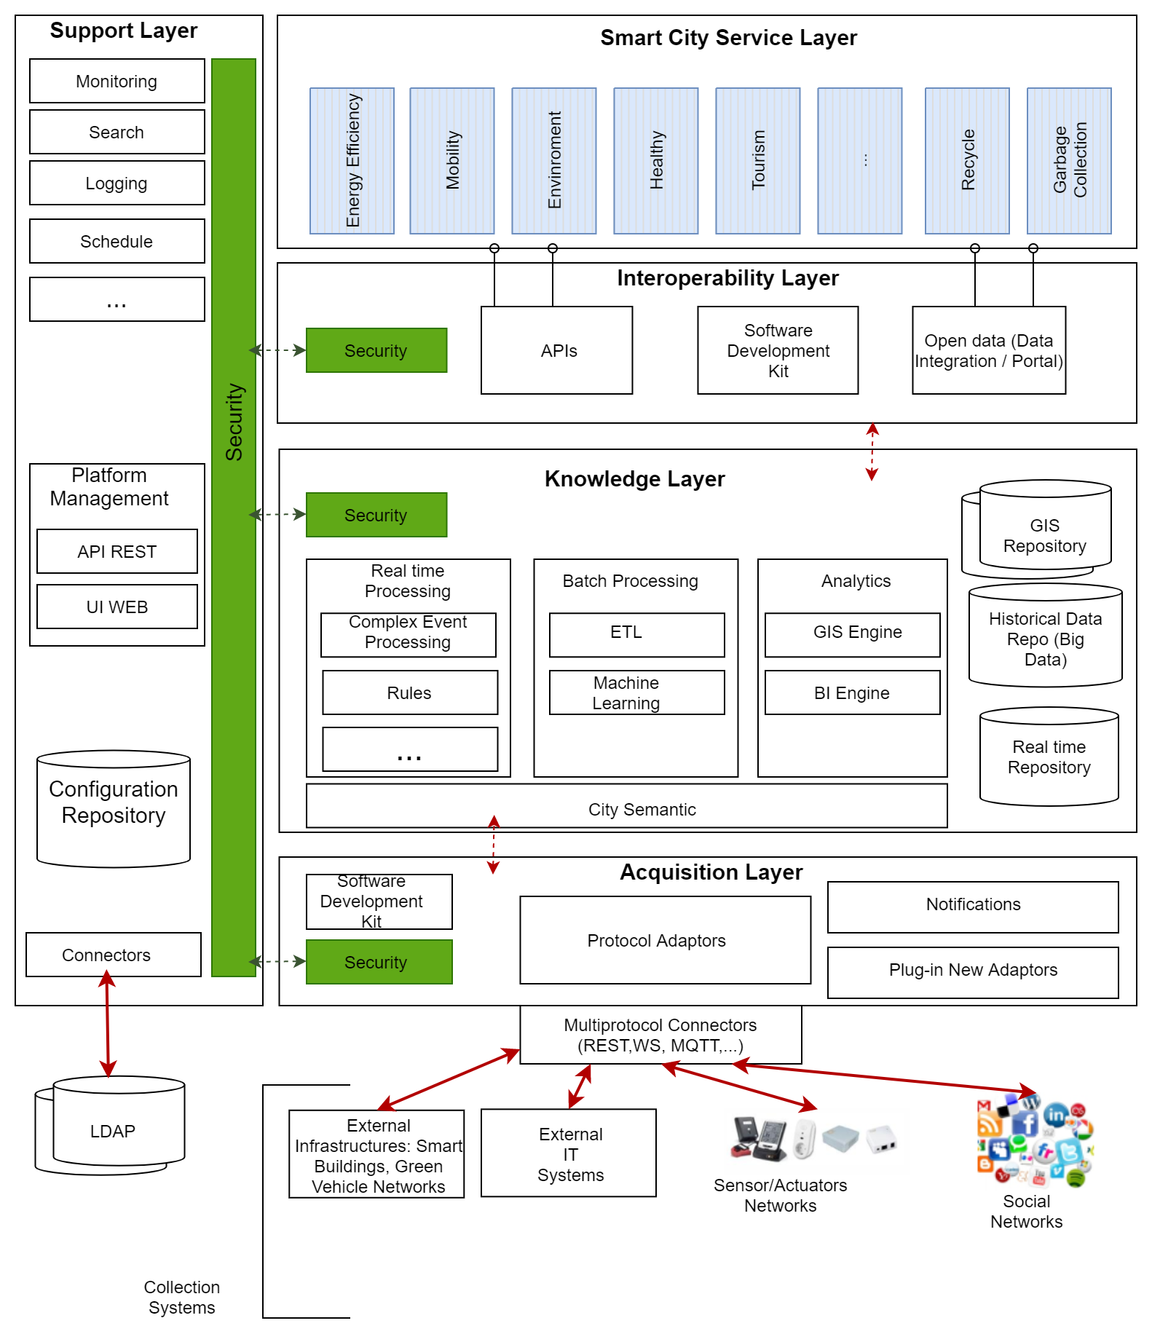
Architecture Reference

Slide 6
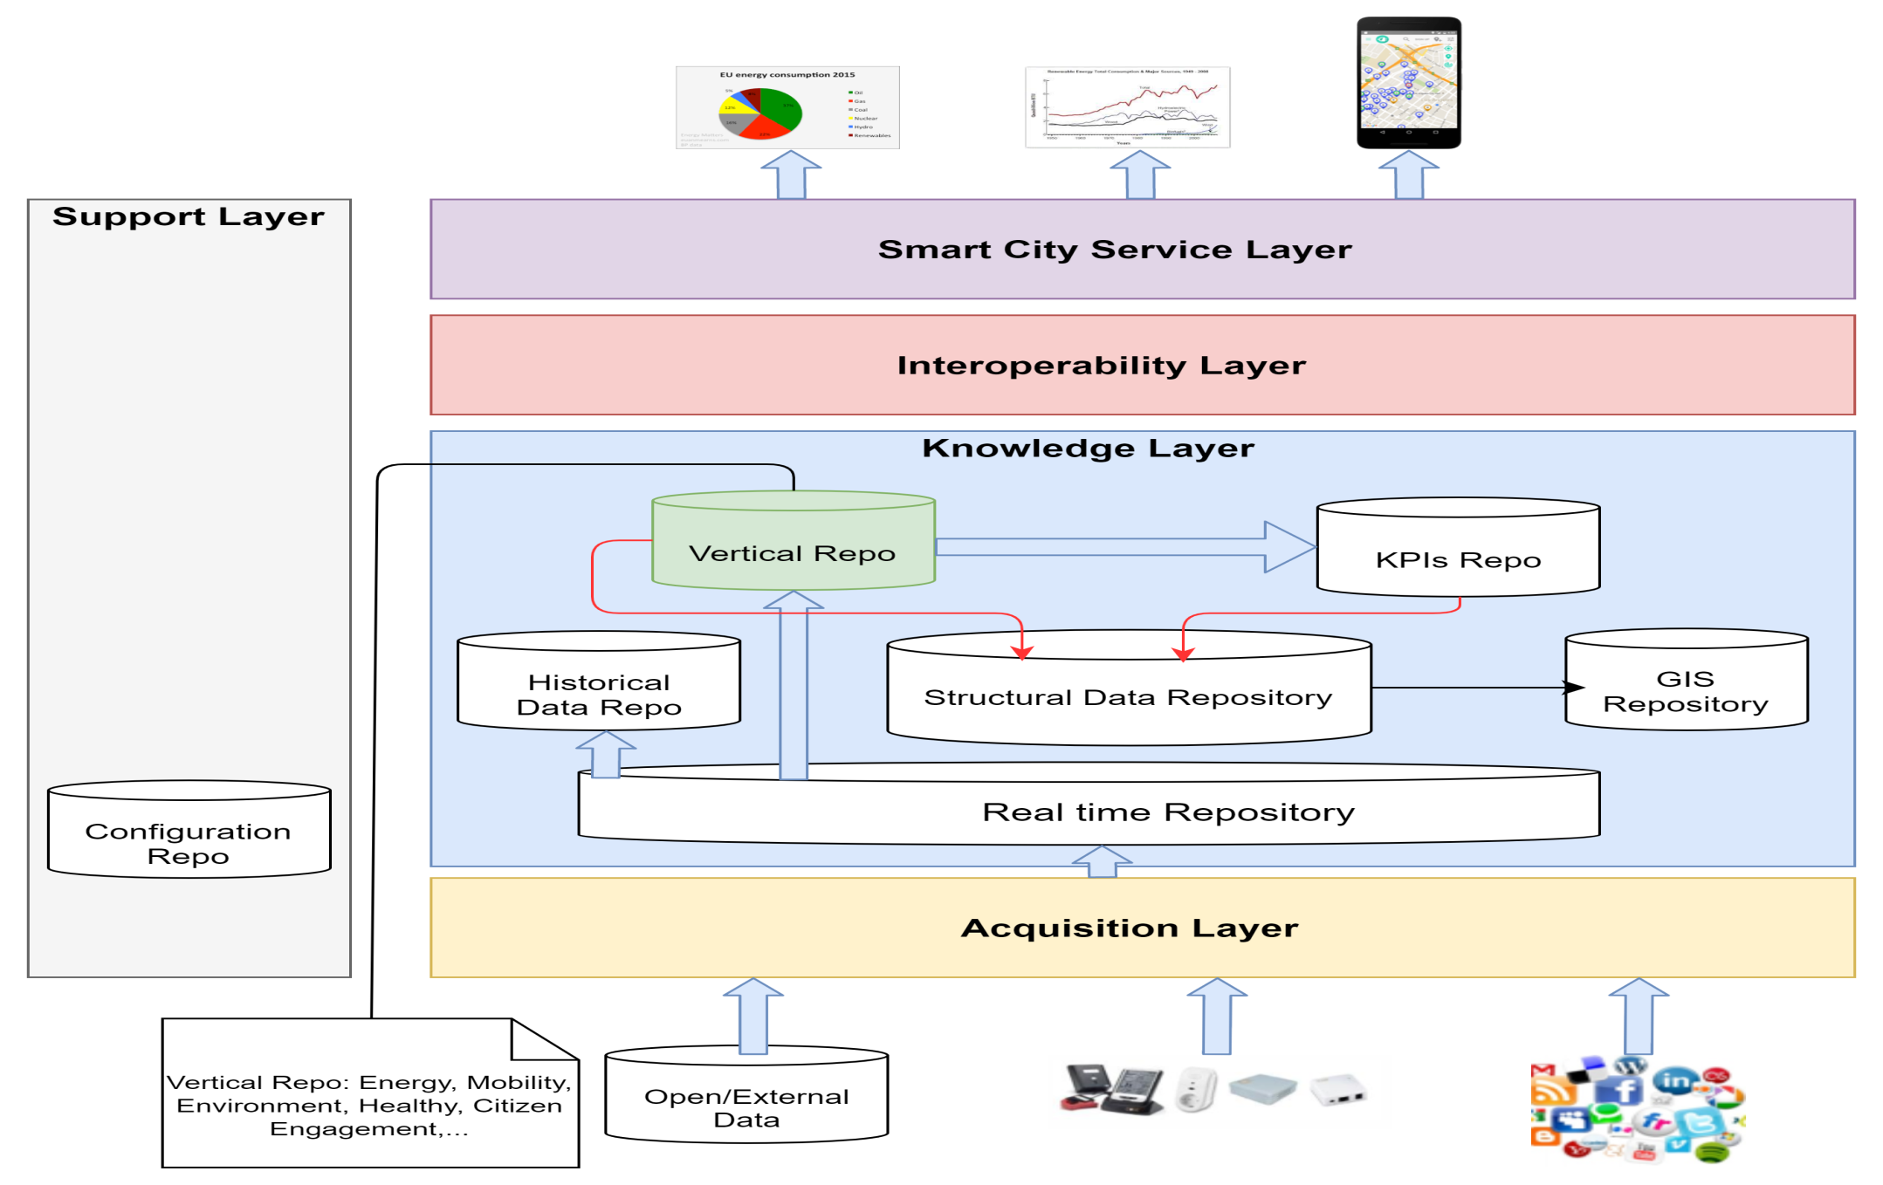
Data Work Flow

Slide 7
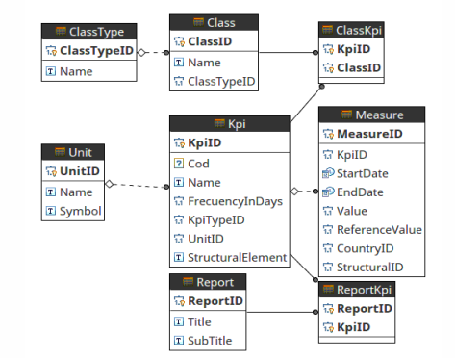
More about KPIs

Slide 8
City Information Open Platform (Examples of implementation)

Slide 9
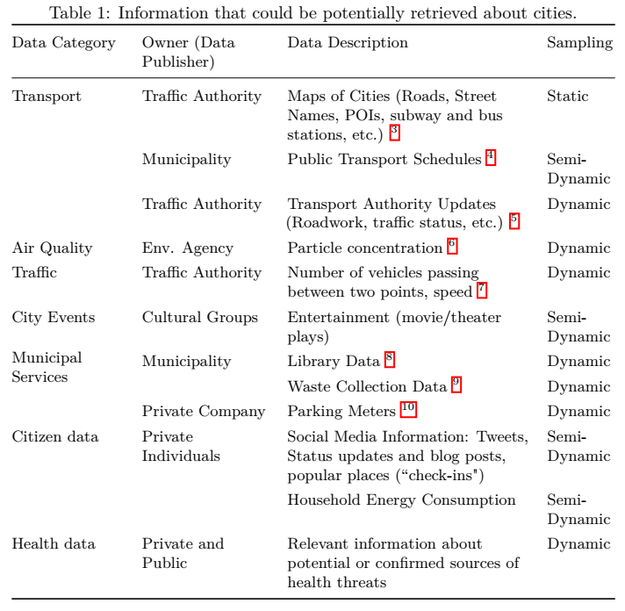
Smart City Data

Slide 10
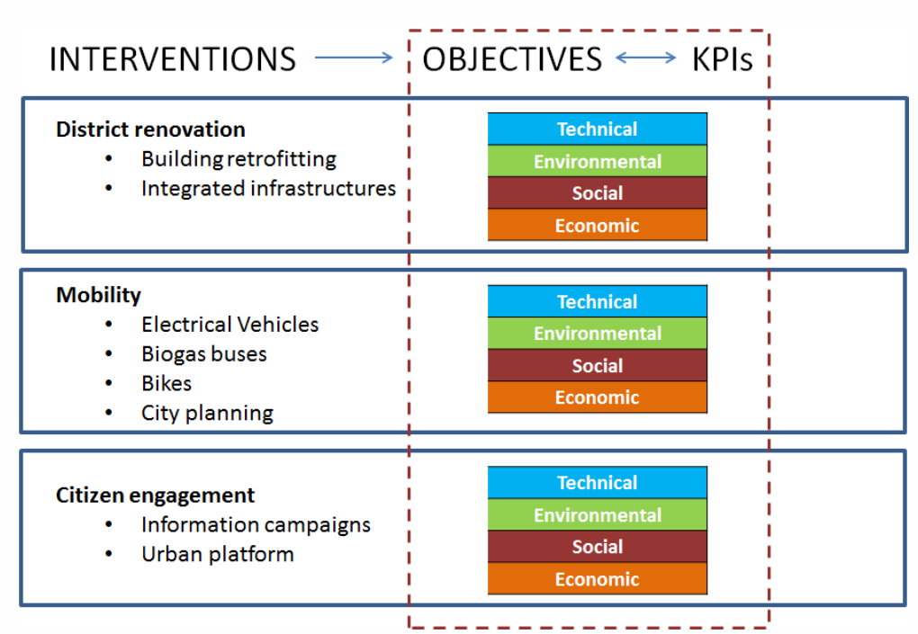
Evaluation of smart city objectives

Slide 11
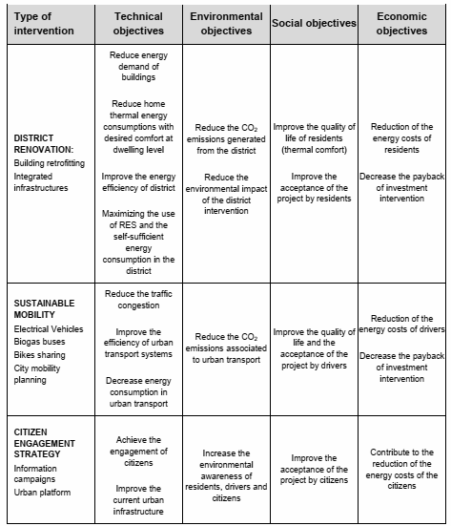
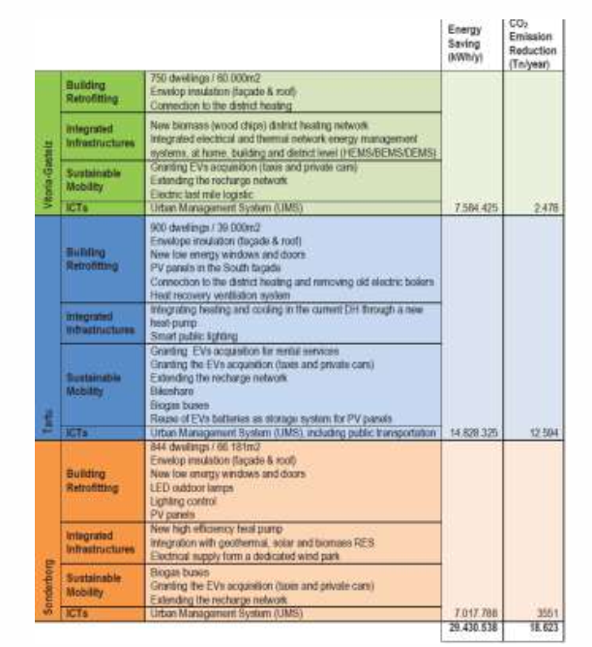
1. Description of the objectives

Slide 12
2. Design action programs
Mobility interventions (Tartu city)
introducing sustainable vehicles (e.g. electric cars, last mile logistic EV services, electric bikes or biogas buses) for public and private use
deploying public and private EV charging infrastructures
providing bike sharing system
re-using EV batteries which allow to storing and using renewable energy
District renovation interventions (Sonderborg city)
building envelope insulation, new energy efficient windows and doors
installation of ventilation systems with heat recovery
upgrading of district heating and cooling networks
introducing solar panels and street lighting with intelligent controlling systems.

Slide 13
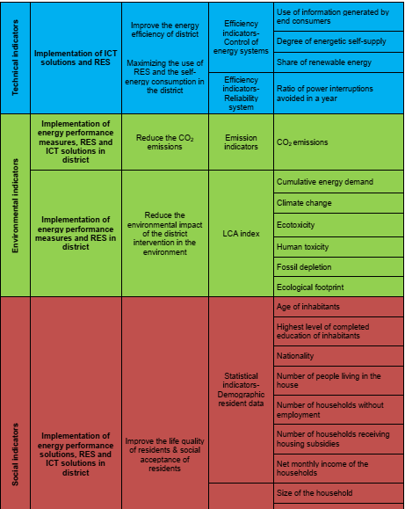
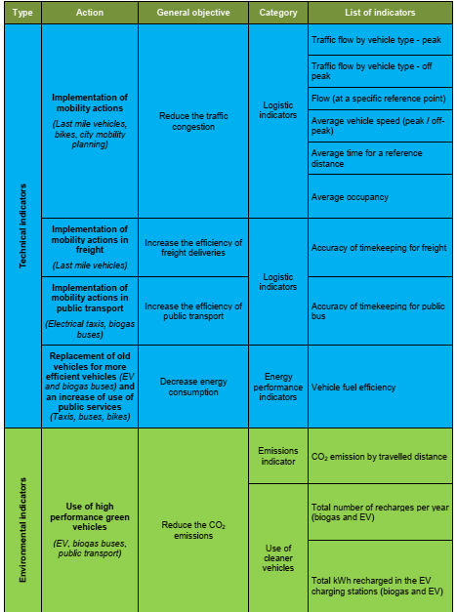
3. Definition of Key Performance Indicators
(*) Refer to (3) for more details of KPIs definition

Slide 14
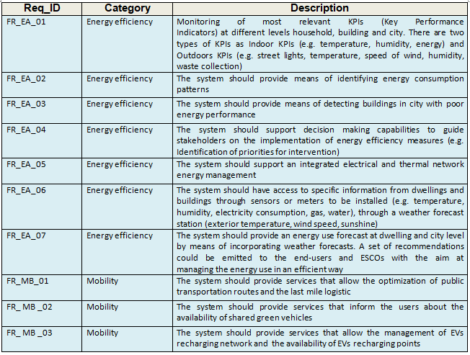
Functional Requirements (1)

Slide 15
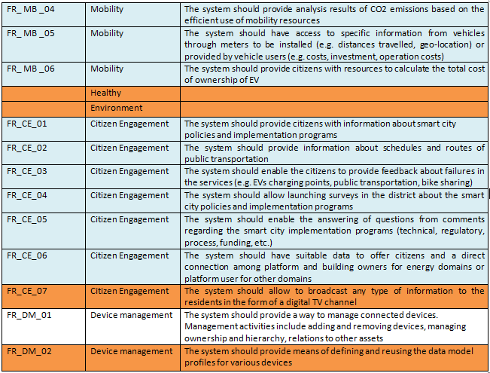
Functional Requirements (2)

Slide 16
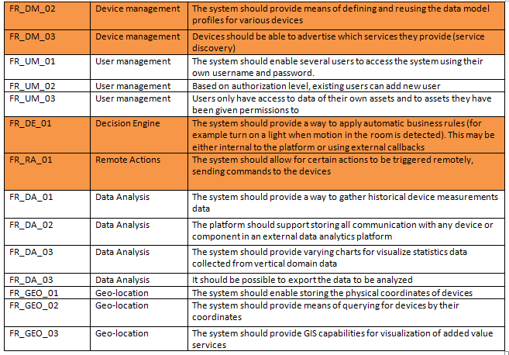
Functional Requirements (3)

Slide 17
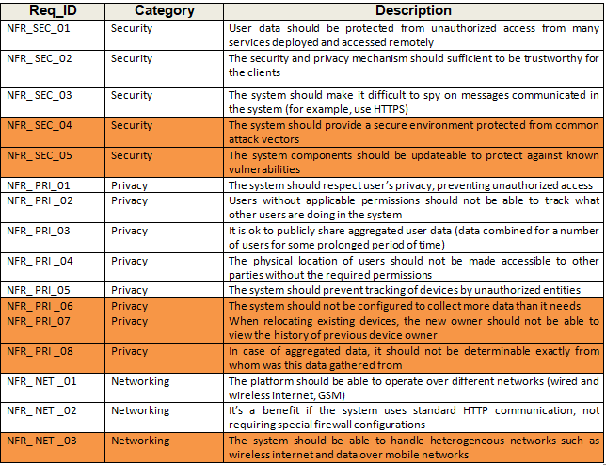
Non-Functional Requirements (1)

Slide 18
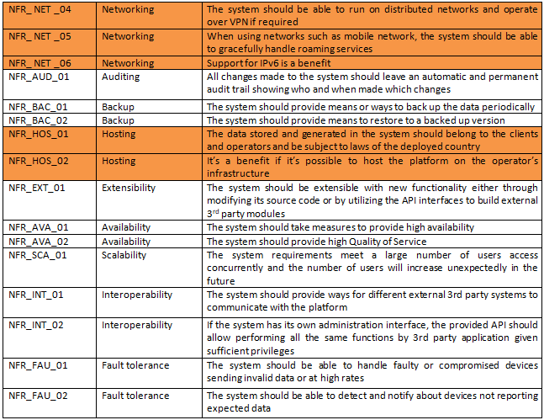
Non-Functional Requirements (2)

Slide 19
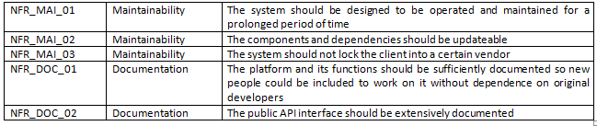
Non-Functional Requirements (3)

Slide 20
Business Use Cases

Slide 21
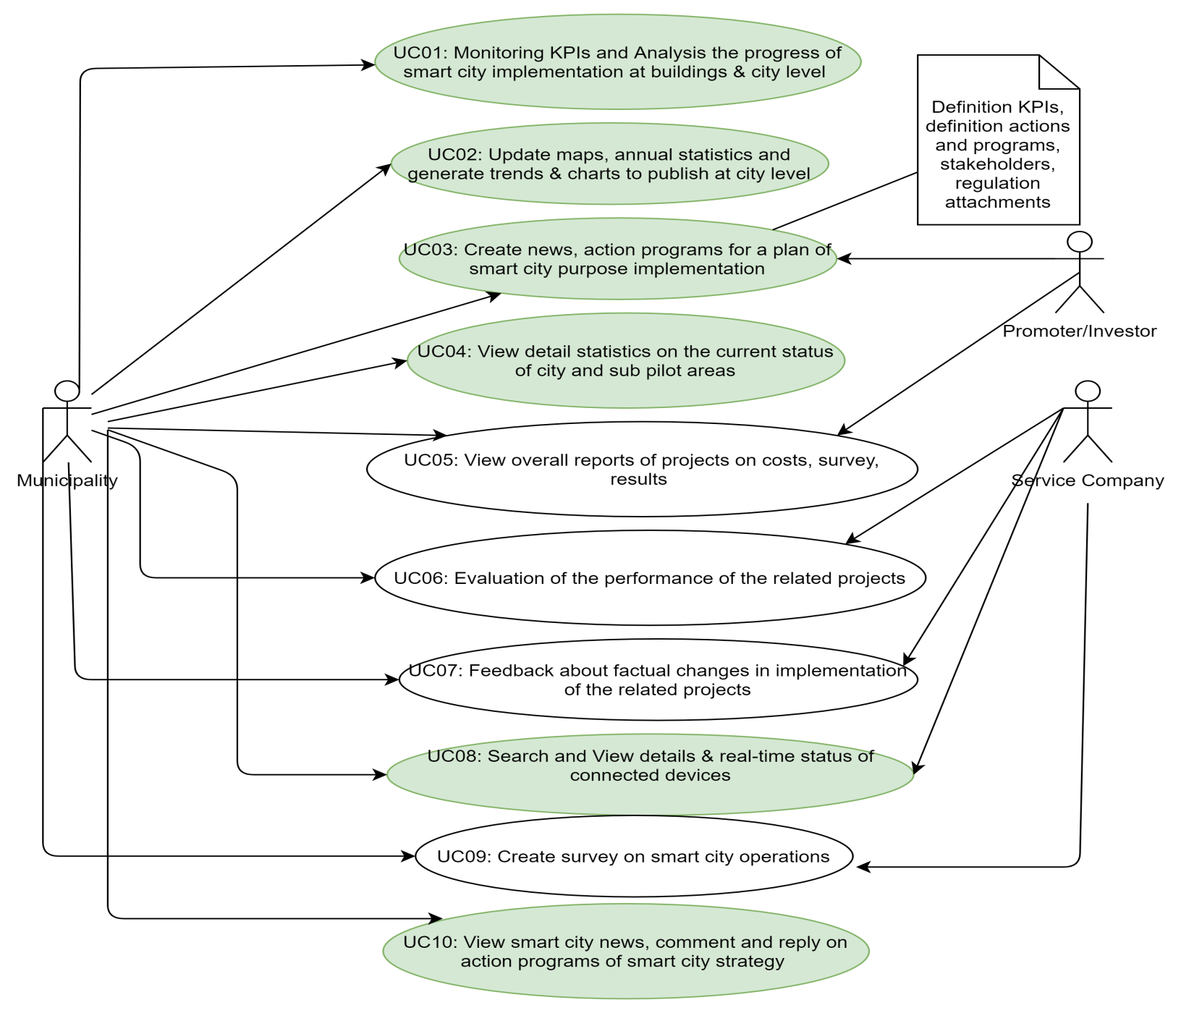
Business Use Case Diagram (1)

Slide 22
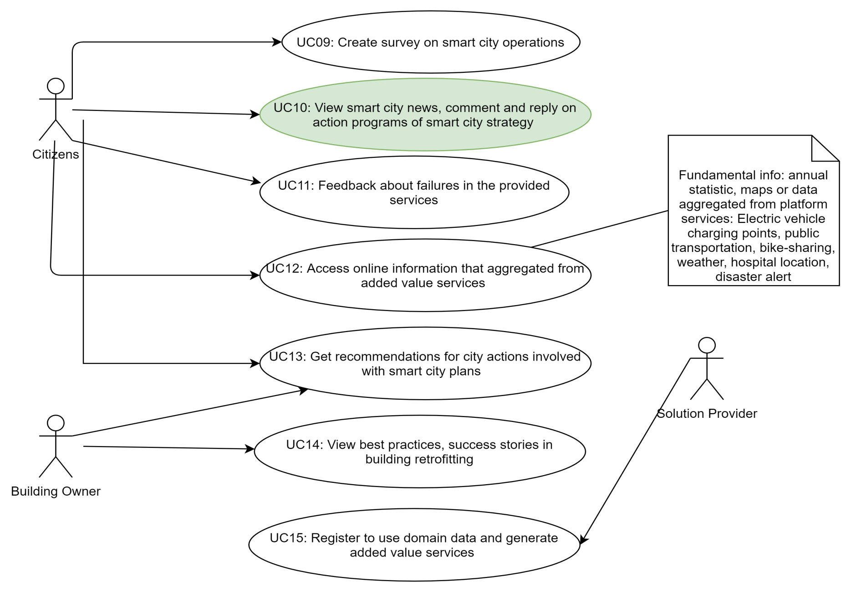
Business Use Case Diagram (2)

Slide 23
References
https://smartencity.eu/outcomes/public-papers/
http://www.smart-cities.eu/
KPIs definition: https://smartencity.eu/news/detail/?rx_call=114

